Slide 1

Data Visualization
23

Slide 2
Data Visualization
A powerful tool to understand, interpret, and present data
Transforms complex datasets into clear, actionable insights
Helps uncover patterns, trends, and outliers
Essential for communicating data findings to stakeholders
Why it matters: Enables faster decision-making and data-driven conclusions
24

Slide 3
Data Visualization
Histograms: Show data distribution
Boxplots: Show data spread and outliers
Scatter Plots: Show relationships between two variables
25

Slide 4
Histograms:
Visualizes the frequency distribution of continuous data
Application in Data Science: Helps identify data patterns, distributions, and outliers
Example:
Monthly sales data: $100, $200, $300, $400, $500
Histogram shows the frequency of sales in each price range
Why It’s Important: Essential for exploratory data analysis (EDA) and understanding data distribution before modeling
26

Slide 5
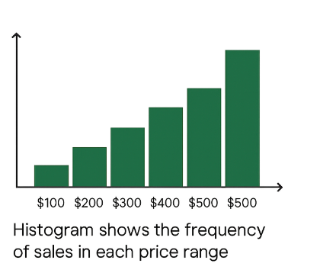
Histograms:
27

Slide 6
Boxplots:
Summarizes data distribution, highlighting central tendency and potential outliers
Application in Data Science: Used for comparing datasets and detecting outliers in data analysis
Example:
Data: {10, 20, 30, 40, 50}
Boxplot shows the median, quartiles, and any data points outside of the upper and lower whiskers (outliers)
Why It’s Important: Essential for data cleaning and identifying data anomalies that may need to be handled before analysis
2

Slide 7
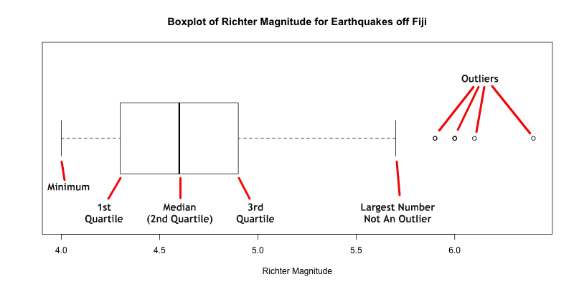
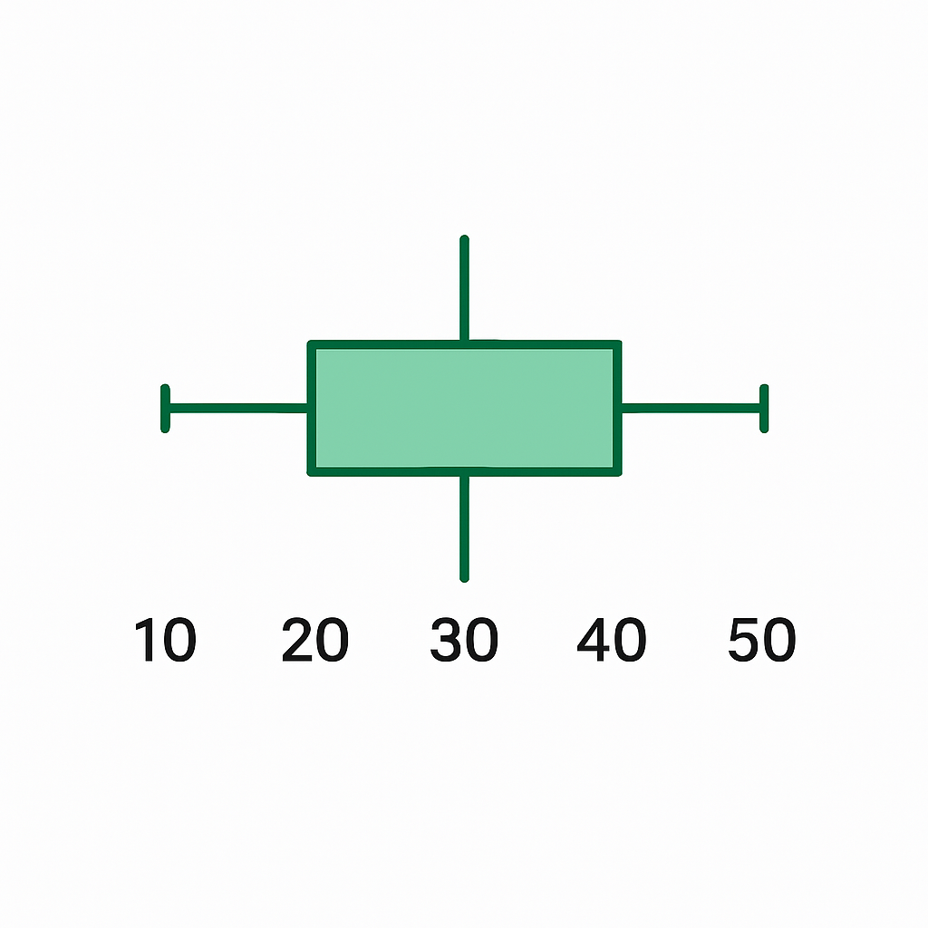
Boxplots:
Example:
Data: {10, 20, 30, 40, 50}
Features of a boxplot
29

Slide 8
Scatterplots:
Visualizes the relationship between two continuous variables
Application in Data Science: Used to identify correlations and trends between variables
Example:
Data: Advertising spend ($) vs Sales ($)
Scatter plot shows whether higher ad spend correlates with higher sales
Why It’s Important: Critical for feature selection, correlation analysis, and identifying trends for predictive modeling
30

Slide 9
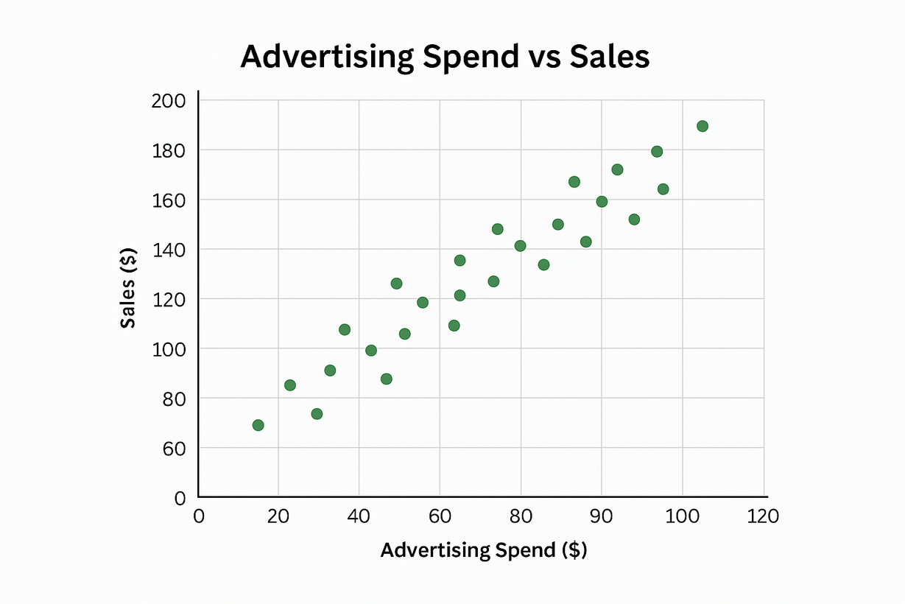
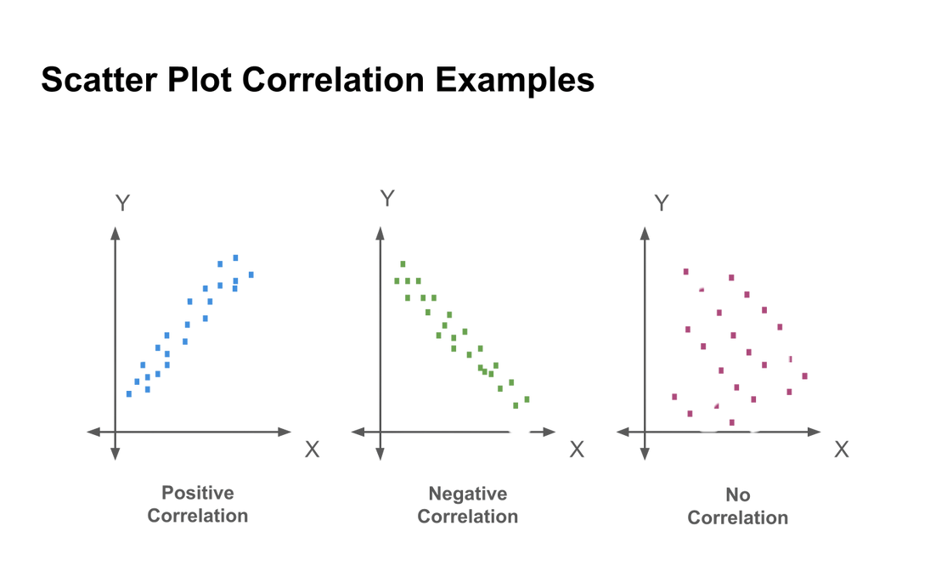
Scatter Plots
31

